Slide 1
What is blogging?
Tuesday 2 February 2016

Slide 2
WHAT IS BLOGGING?
Blogging is first and foremost a fantastic way to strengthen the connections between home and school.
Overall, blogging is a platform for everything. It is a fantastic place to start for teachers and students who want to learn about technology.

Slide 3
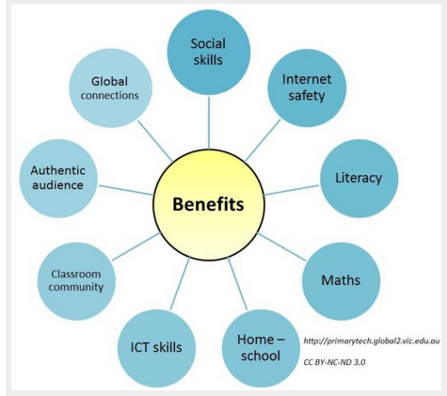
WHAT ARE THE BENEFITS?
Improvement of literacy skills
Not only were skills improved, but engagement levels increased. Reluctant writers wanted to write for a purpose and students were using blogs to purposefully communicate and converse with others.
Authentic Audience
Blogs provide a much larger audience for student work and an avenue for feedback and self-improvement through commenting.
Sense of classroom community
Creating a class blog requires teamwork and collaboration. Students and teachers learn and share their learning together.
ICT skills
Blogging assists students to become more ICT literate which is an important 21st century skill
E-Safety
Everyone will agree that teaching students to be safe online is an important issue. You can’t just do one off lessons on cyber safety. Cyber safety is not a separate subject. Through being heavily involved in blogging, children have opportunities almost every day to discuss cyber safety issues and appropriate online behaviour.

Slide 4
HOME-SCHOOL CONNECTIONS
A class blog helps to provide a virtual window into the classroom.
Most families enjoy being able to keep up to date with classroom events and children’s learning

